Slide 1

Who is changing names and why?
Reviewing a decade of name change trends: 2010 - 2019
The Australian Name Change Survey 2020
n: 1,389 surveyed respondents between 2010-2019
Source: registrations at www.easynamechange.com/au, site visitors, Facebook page & wedding and divorce site promos
© Copyright 2020 Wired Living Pty Ltd. May be reproduced with credit to www.easynamechange.com/au

Slide 2
Name Change Highlights: 2010-2020
Females dominate all areas of name change. While there’s no surprises with marriage and divorce name change, women are also 40% more likely to change their names legally.
Traditional choices are stronger than ever, with over 75% of women who change names ditching their maiden name altogether. This has been a steady year on year increased since 2010.
2019 saw a step change in gender attitudes to married name change. 67% agreed or strongly agreed that ‘It should be socially acceptable and encouraged for men to change names’. Less than half agreed in all previous surveys .
Family unity is still the driving reason for respondents to take their spouse’s surname.
While still a very small number overall, more men seem to be changing names due to relationships (marriage and divorce!)
It doesn’t matter how long you’ve lived with a married name for; the length of the relationship and the respondent’s age are not influencing factors when it comes to reverting to a prior name.
Women changing their name from divorce are so much sure of their decision, resulting in them feeling happier, more confident and having an improved sense of identity.
There is no ‘typical’ person who legally changes names. Respondents are spread across all ages and have many different reasons for making the change.
One third of legal name change respondents changed only their last name.
Just over one third of respondents changed names to either join a family or no longer want to be considered as part of a family.
Transgender or name not suiting gender has emerged as a clear trend in 2019, where previously it was too small to be reported on separately.

Slide 3
Name Change by Gender
In 2019 males account for 13% of all name changes, a significant increase on previous years. In 2019 we introduced non-binary gender, identifying with 2% of all respondents and 5% of legal name change respondents.

Slide 4
Name change types by Gender
Name change is dominated by women, even for legal name change. Men are more likely to change names for reasons other than marriage, however a small number of men do change names following a change of relationship status. Typically 2% of men have taken or removed their partner’s names, as high as 5% in 2019
All respondents - 2010-2019

Slide 5
Age When Changing Names
Two in three married name change respondents are between 25 – 34 years old.
Two in three people reverting to their prior name are aged between 40-59 years.
Legal name change is more spread across the years, similarly represented in all decades.
All respondents - 2010-2019

Slide 6

Legal Name Change

Slide 7
Legal Name Change: Summary
There’s no typical legal name change story or respondent! It’s spread across ages, genders and reasons.
Women are overrepresented, accounting for 58% of legal name change respondents (people who legally changed names due to a change of relationship status are not in this group)
In 2019 we had 6% of respondents attributing their name change due to their gender not suiting their name or from being transgender. In previous years we did not have enough respondents identifying gender as the motivating factor for changing names.

Slide 8
Legal Name Change by Gender
Women are over represented with legal name change. (Note: this sample excludes people undertaking a legal name change that originates from marriage or divorce.)
We introduced a new gender in 2019. 5% of our 2019 legal name change respondents identified as ‘Non-binary’(excluded from 2010-19 summary above)
All legal name change respondents: 2010-2019

Slide 9
Adult Legal Name Change Respondent by Age
Legal Name Change is undertaken by people across all ages.
All legal name change respondents – 2010-2019

Slide 10
Reasons for legally changing names
There are so many reasons why individuals legally change name. Reasons not listed above include domestic violence, names difficult to pronounce or spell, going back to an intended birth name and BDM error. These have been common reasons over time.
All LNC respondents 2010 – 2019
Q: What best describes your situation?

Slide 11
What names do people change?
One third of all respondents change only their surname. This is understandable given that over 30% of people who legally change names do so because they want to join or affirm their place in a family, or no longer want to be considered part of a family.
All LNC respondents 2010 – 2019
Q: Which name/s did you change?

Slide 12
Legal Name Change: Feeling good about your choice.
Happier, More Confident & Improved Identity
Legal name change respondents report comparable emotions as respondents who are removing their partner’s name. They are more confident, happier and have an improved sense of identity.
All respondents 2012 – 2019
Q: How do you feel about the following statements
Strongly agree, agree, neutral (2.5), disagree, strongly disagree.
Index of 5

Slide 13
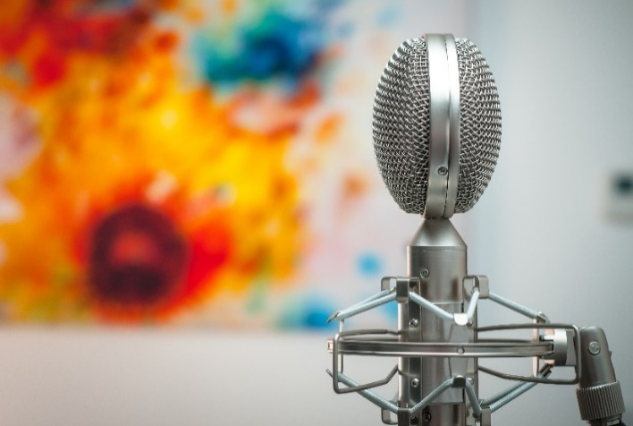
Stories with media approval (Legal name change p1)
Step families
When I finalised the forms and was ready to take them in I called my mother and step father (whose name I was taking) to ask permission. I'd never seen my step father cry, but he did that day and it reaffirmed my decision to take the name of the most stable male figure in my life.
I decided to change my name from my birth father name out of complete respect to my step dad, who raised me from when I was a toddler. I didn't tell him until after I did the name change and he is a very quiet man but was completely over the moon by the change. It felt completely right and it's something I will never ever regret.
These respondents are happy to be interviewed for stories in the media.
Dad stuffed the baby’s name
When I wad born my mother put on a piece of paper the way my name was to be spelled. My dad lost the piece of paper by the time he got to the registrar office. The official asked my dad how they would like my name to spelled. Dad lost the piece of paper and had to spell it the common way. Mum was angry to say the least.
2019 legal name change respondents

Slide 14
Stories with media approval (Legal name change p2)
Loss of cultural heritage
Since moving from NZ to Aus in 2006 with my 4yr old daughter, I noticed as she got to the age of 13 I could see her sense of identity loss of our Kiwi and Samoan heritage from wing here for so long. She has no understanding of our culture and protocols, pride and humility as she has never grown up in NZ. So since our original surname was ...a pretty common surname, I decided to change both our names to my mothers Surname which is ....Samoan. I noticed her confidence and identity improve since then. She and I are both very proud and happy we changed it.
Indigenous adoption
My Foster Brother is unable to be adopted because he has some Indigenous in his background, he has pleded with the Fostering Agency to please allow him to change his surname to his fostered family surname, he has been part of this family since he was 8 weeks old, he is now 13 years old and desperately wants his Identity with the family he loves and has grown up with but unfortunately the agency has refused his requests to the point where he has become very depressed.
New Identity
Well I think it was the trauma and losses of black sat that triggered the new name as my Christian name is uncommon too . Those I was speaking to, faced such losses and the I got used to it and the name fitted int email spaces and forms - yes a bit of grieving and a welcoming of a new identity
Formalising nicknames
My nickname for my entire adult life has been Mem. My birth name is Emily. Mem is what I go by. The less I got called Emily, the more I disconnected from it, and it got to the point where hearing it was grating on me and making me uncomfortable, especially when people regularly would ask me what Mem was short for. I legally changed my name to Memily, though I still go by Mem—I didn’t entirely erase my birth name but found a place of comfort where I could answer what it was short for without feeling an uncomfortable disconnect.
2019 legal name change respondents

Slide 15

Transgender: Stories with media approval
As a student
I came out as transgender and decided to change my name. As I am a student at school this was quite difficult as I had to provide multiple pieces of documentation to change my name in both the school and state records so my school results could be printed in the correct name. This was very difficult and I still cannot change my gender marker to the correct one without invasive surgery.
Surprised later in life
I changed my name due to transitioning from male to female. I knew I should have been a girl when I was 8 and chose my female name when I was 13. When I was 54 I discovered I was born intersex and modified at birth to be male, a small point which my parents forgot to mention! I went a little off the rails for 8 months before making the decision to become the person I knew I should always have been. I have to say I have never felt this happy or content before and I owe most of it to my amazing partner who knew it was the right thing to do and has supported me through the process.
These respondents are happy to be interviewed for stories in the media.
2019 legal name change respondents

Slide 16

REVERTING TO FORMER NAME
Divorce, separation & reverting to former name

Slide 17
Reverting to Prior Name: Summary
While 78% of all respondents were divorced, this summary includes anyone separated or who preferred their former name.
Men are also represented, averaging 2 % of all respondents over the years
The respondent’s age and the number of years they have been known by their married name does not deter them from going back to a former name. If anything, respondents are likely to be older and married longer.
While 84% will go back to their former name, 9% of respondents take the plunge with an entirely new name.
Unlike newlyweds who have no strong emotions when changing names, these respondents are happier (89%), more confident (74%) and have an improved sense of identity (90%) when they change names.

Slide 18
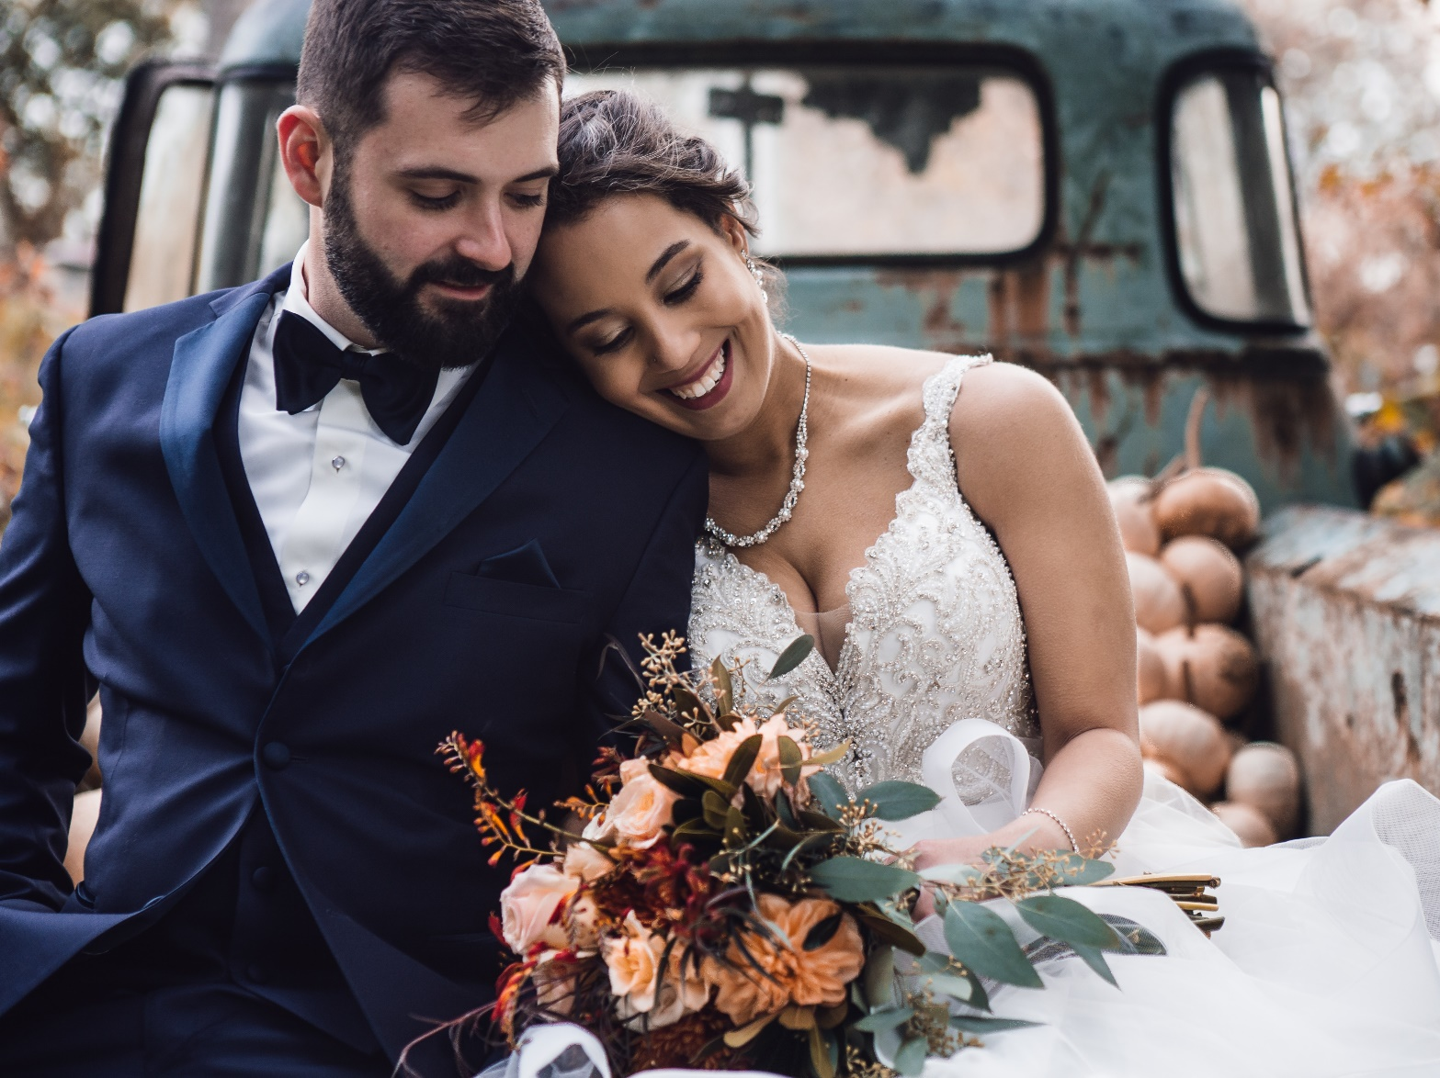
MARRIED NAME CHANGE

Slide 19
Married Name Change: Summary
While the vast majority of married name change respondents were female, we consistently find about 2% of respondents are male, peaking at 4% in 2019.
We’re still very conservative in our name change choices with 70% dropping their former name and taking their spouse’s surname, consistent across the years.
The primary driver for changing names after marriage is wanting the “whole family to have the same name”.
Married name change is seen as a bit of a chore; for those who put off the change for more than 6 months it’s because they are too busy, or because they can’t get to branches during business hours.
Why don’t men more change names on marriage? In 2019 we saw a step change! Now over two-thirds believe that ‘It should be socially acceptable and encouraged for men to change names’. Previously this has always had less than half of respondents agree.
  And we are seeing more men change names on marriage in 2019, but only 4%
Newlyweds are not particularly excited about changing names. They don’t report any significant increase in confidence, happiness or having an improved sense of identity.
Age plays a part in trends and attitudes: Newlyweds 35+ are more likely to believe married name change is an annoying tradition we still follow and that it makes a gender/political statement.
Newlyweds under 30 are more likely to be happier and more confident, where newlyweds 35+ are more neutral about changing names.

Slide 20
Need more?
You’re just viewing the highlights!
We have more detailed information for all name change types. If you need a specific question asked or data rearranged reach out to Easy Name Change!
Genevieve Dennis
Marketing Manager & Founder
gen@easynamechange.com
03 9015 7699 | 0413 232 703
www.easynamechange.com/au

